Slide 1
Age and Gender Classification
Under the Guidance of
Ms. S. Rama Devi
Associate Professor
Team: 17
16WH1A1235 – K. Shreya
16WH1A1255 – Shaik Sumera Sultana
16WH1A1257 – T. Alekhya

Slide 2
CONTENTS
Introduction
Objective
Dataset
Technologies
Approach
Model
Implementation
Output
Plan of Action
Conclusion

Slide 3
INTRODUCTION
Age and gender classification are important factors of face analysis and these play a foundational role in social interactions.
There are numerous applications for age and gender estimation such as
Law Enforcement
The Surveillance
Advertising Industry etc

Slide 4
OBJECTIVE
The objective of this project is to recognize the facial attributes including age and gender using machine learning algorithms.
This project is based on Convolutional Neural Networks to classify images into respective classes .

Slide 5
DATASET
IMDB – WIKI dataset is used.
Over 62,000 images of male and female are used.
Images of all age groups are used for age detection.
The dataset consists of different images of different sizes and are in the format of .jpg

Slide 6
technologies
Coding Language : Python 3
IDE : Jupyter Notebook
Cloud Service : Google Colaboratory

Slide 7
approach
The steps followed are
Detect the faces
Classify into Male/Female
Classify into one of the 13 age ranges (0 – 5), (6 – 10), (11 – 15), (16 – 20), (21 – 25), (26 – 30), (31 – 35), (36 – 40), (41 – 45), (46 – 50), (51 – 55), (56 - 60), (61 – 100).
Put the results on the image and display it to the user.

Slide 8
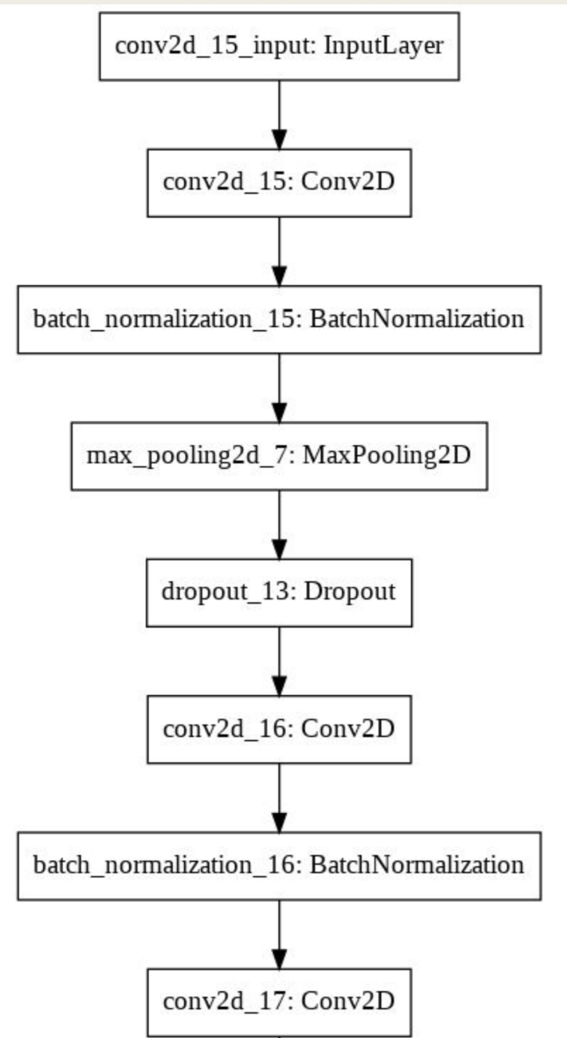
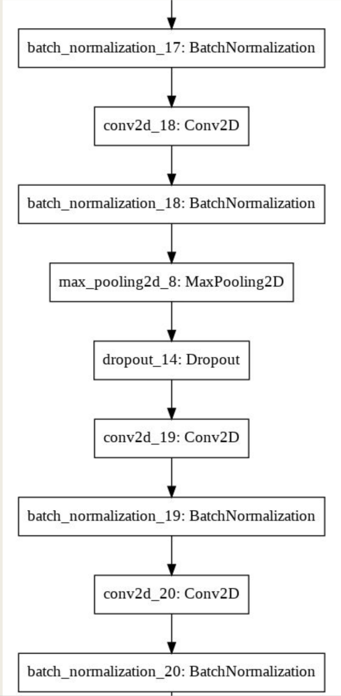
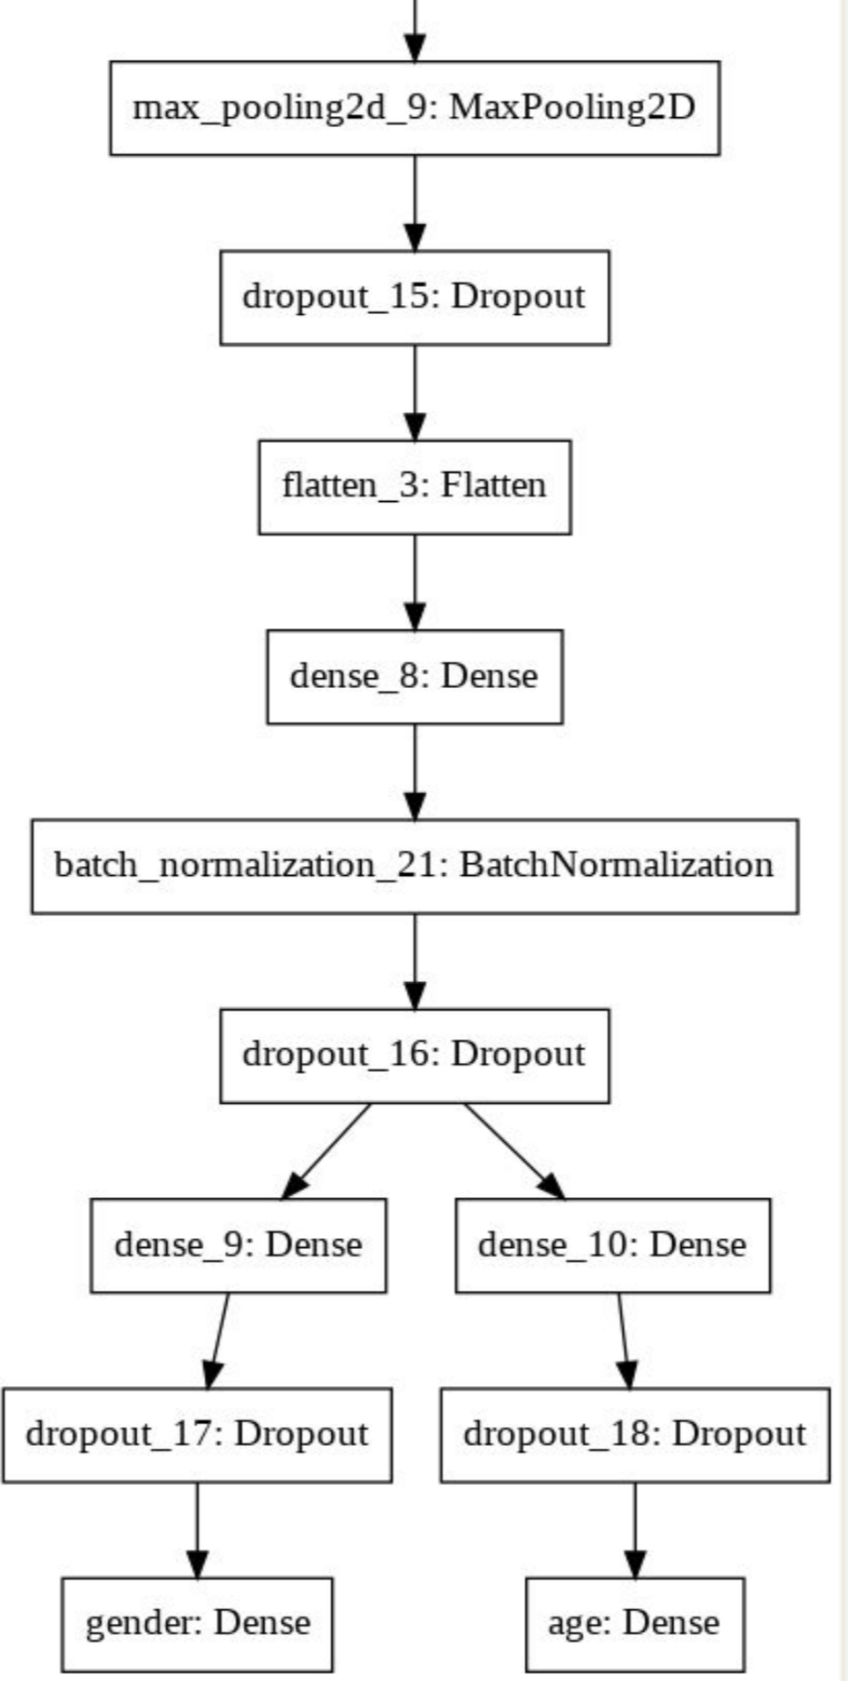
model

Slide 9
Implementation
CNN MODEL
inputShape=(64,64,3)
model= Sequential()
model.add(Conv2D(32,(3,3),padding="same",input_shape=inputShape,activation='relu'))
model.add(BatchNormalization())
model.add(MaxPooling2D(pool_size=(3,3)))
model.add(Dropout(0.25))
model.add(Flatten())

Slide 10
Face Detection
OpenCV provides the CascadeClassifier class that can be used to create a cascade classifier for face detection. This classifier is loaded as follows
classifier=CascadeClassifier('haarcascade_frontalface_default.xml')
Perform face detection on an image by calling the detectMultiScale() function. The image can be loaded by using imread() function which is present in OpenCv.
path="/content/wiki_crop/05/10024005_1955-12-24_2012.jpg"
image = cv2.imread(path)

Slide 11
Classifying the age and gender
int_to_gen = {0: 'female',1: 'male'}
int_to_age = {0: '(0-5)', 1: '(6-10)', 2: '(11-15)', 3:'(16-20)', 4:'(21-25)', 5:'(26-30)', 6:'(31-35)', 7:'(36-40)', 8:'(41-45)', 9:'(46-50)', 10:'(51-55)', 11:'(56-60)', 12:'(61-100)’ }
Testing
a = load_model("/content/trainedmodel.h5")
cv2.rectangle(image,(x,y),(x+w,y+h),(0,255,0),2)
ans=a.predict(np.expand_dims(i,0))
gender=int_to_gen[ans[0].argmax()]
age=int_to_age[ans[1].argmax()]
cv2.putText(image, gender+' '+age, (x,y-5), cv2.FONT_HERSHEY_SIMPLEX, 0.5, (0,255,0), 2)

Slide 12
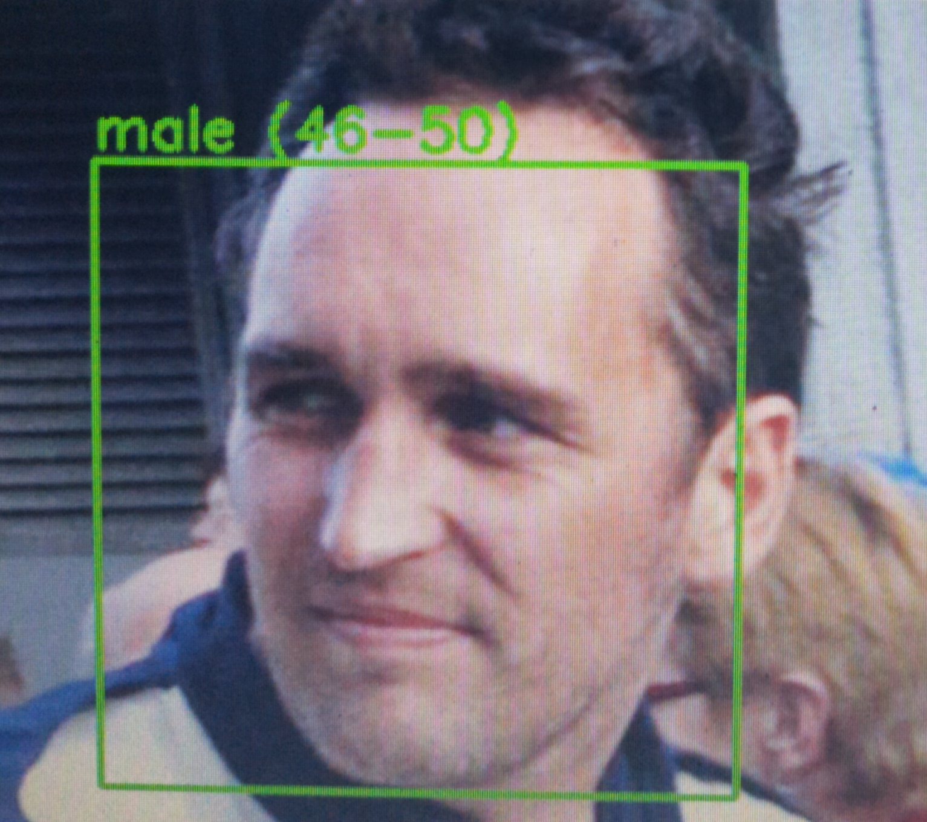
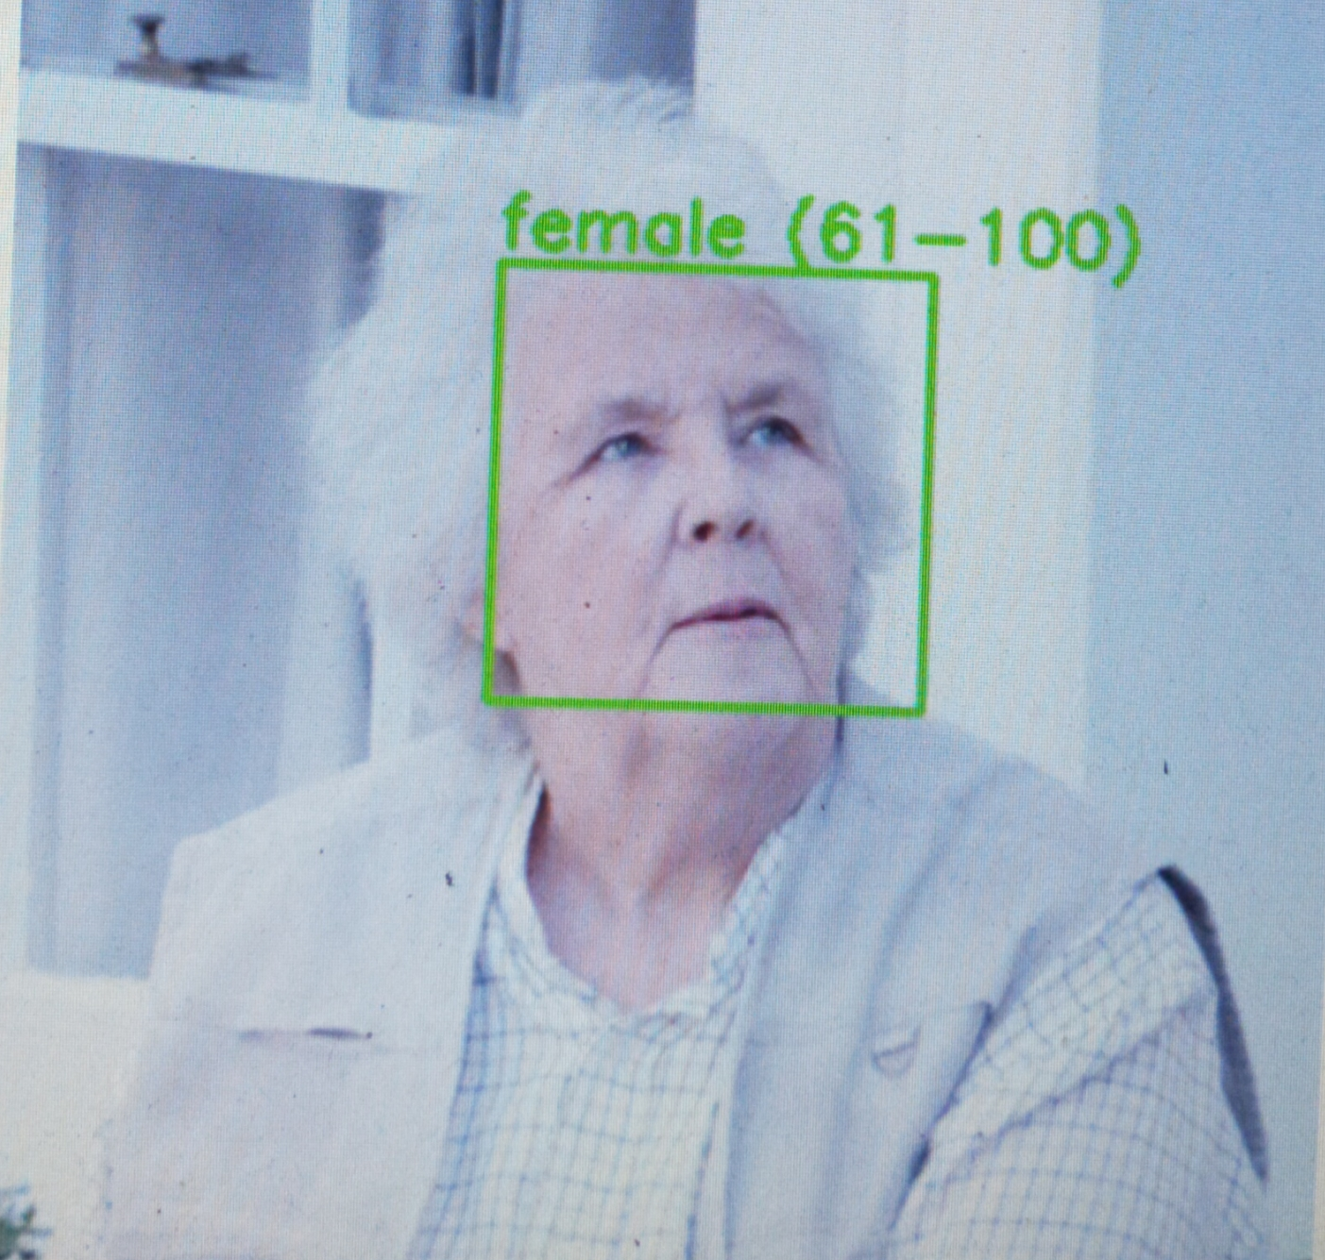
output

Slide 13
Conclusion
CNN model is efficient for image classification.
Increase in dataset can result in more accuracy.
FUTURE SCOPE
This project can be enhanced by taking in more features into account like we can classify the images based on the emotion.

Slide 14
Plan of action
Module Information | Status | Time required to complete
Literature Survey | Completed | 1 week
Requirement Analysis | Completed | 1 week
Design | Completed | 2 weeks
Implementation | Completed | 4 weeks
Documentation | Completed | 2 weeks

Slide 15
REferences
https://ieeexplore.ieee.org/document/7301352
https://docs.opencv.org/2.4/modules/contrib/doc/facerec/tutorial/facerec_gender_classification.html
https://www.pyimagesearch.com/2018/02/26/face-detection-with-opencv-and-deep-learning/
https://medium.com/analytics-vidhya/how-to-build-a-face-detection-model-in-python-8dc9cecadfe9

Slide 16
THANK YOU

